Slide 1


PROGRESS TRACKER

Slide 2


iNTRODUCTION
Build resilient infrastructure,
promote inclusive and sustainable
industrialization and foster innovation

Slide 3



The pandemic has hit the manufacturing and transport industries hard, causing job losses and declining incomes for workers in those sectors. The crisis poses unprecedented challenges for global value chains by disrupting both the supply of and the demand for goods. Small-scale industries have been severely affected, and many continue to face existential challenges.
PROBLEM

Slide 4

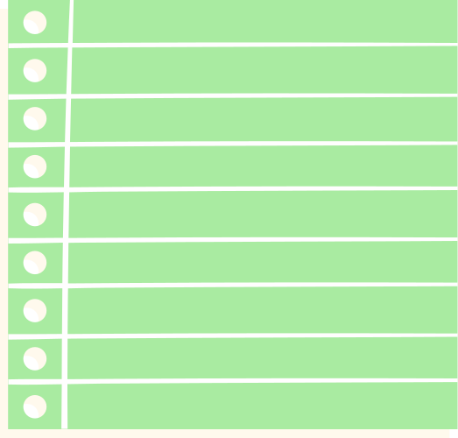



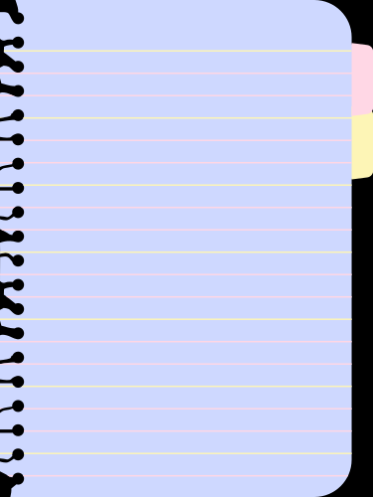



SOLUTION / RESULT
To add value to the organization we are focusing on maintaining employee-organization relationships. By our software, we will keep a trach on employees’ performance (ethical / monitoring spin). This will foster the company to assign proper work as well as rewards to its employee. • This will also help in planning any expansion or merger. • This will be an account for the tangible assets.

Slide 5






FEATURES..
• It would detect the movement of the employee.
• It would detect the meaningful work done by the employee.
• It would detect the hours of the regular sitting of the employees.
• It would display the percentage (%) of the efficient work done by the employee at the end of the day.
• According to the average percentage (%) of the efficient work done in a month by the employee he/she would be rewarded.
• This software will help to choose the employee of the year.
• We will give all the necessary performance visualization to the employee to track his/her performance.
• This software will give the peak of his/her performance graph.

Slide 6
OVERVIEW
This project has been designed by keeping the current scenario in mind. We have deployed a model that will track the performance of each and every employee present in the MNC. This will show the maximum working hours of an employee. This will show the visualization of the performance of each and every employee. By deploying this model in the industry, it will help to boost up the performance of the company, With the economic upliftment of the company, it will generate more jobs.
It will help employees to make his/her personal relations stronger as he/she will complete their daily task in their working time itself only.

Slide 7
WORKING PROCEDURE
• We will deploy software that consists of five phases:
1. Movement detection (Open CV).
2. To detect the meaningful words typed by the employee (Natural Language Processing).
3. Sitting detection (Internet of Things (IoT))
4. Any exceptional case (FLAG)
5.Performance visualization(Data Science)

Slide 8

MOVEMENT DETECTION (OPEN CV)
1. We will use an open CV to detect the movement of the employee.
2. Normal webcam will be used to detect the body movement of the employee in the frame.
3. We will use histograms of oriented gradients.
4. A rectangular frame would appear in the employee’s surroundings.
5. If the employee moves out of the frame or any other person enters the frame it will detect.
6. It will give 10 minutes of relaxation to the employee 4 times a day.
7. The device of that employee will only be opened in the face of that person who matches that employee.

Slide 9
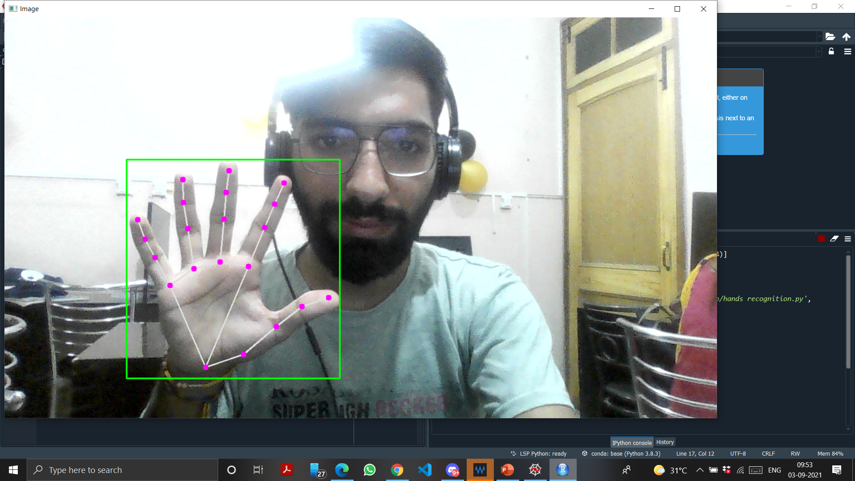

Slide 10
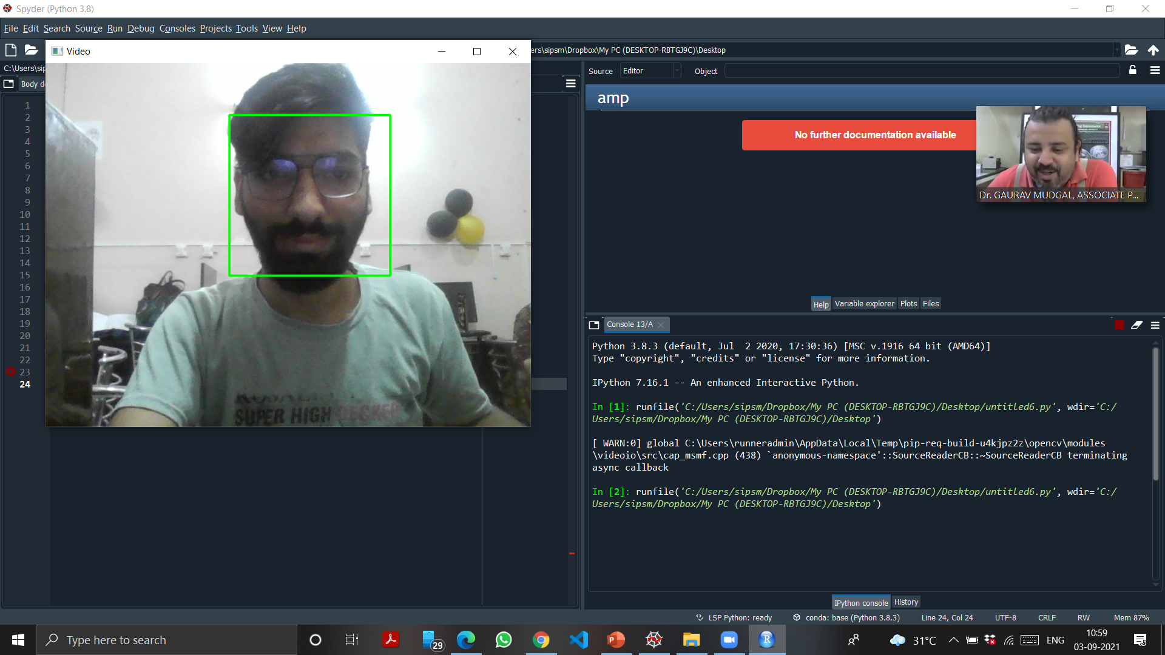

Slide 11
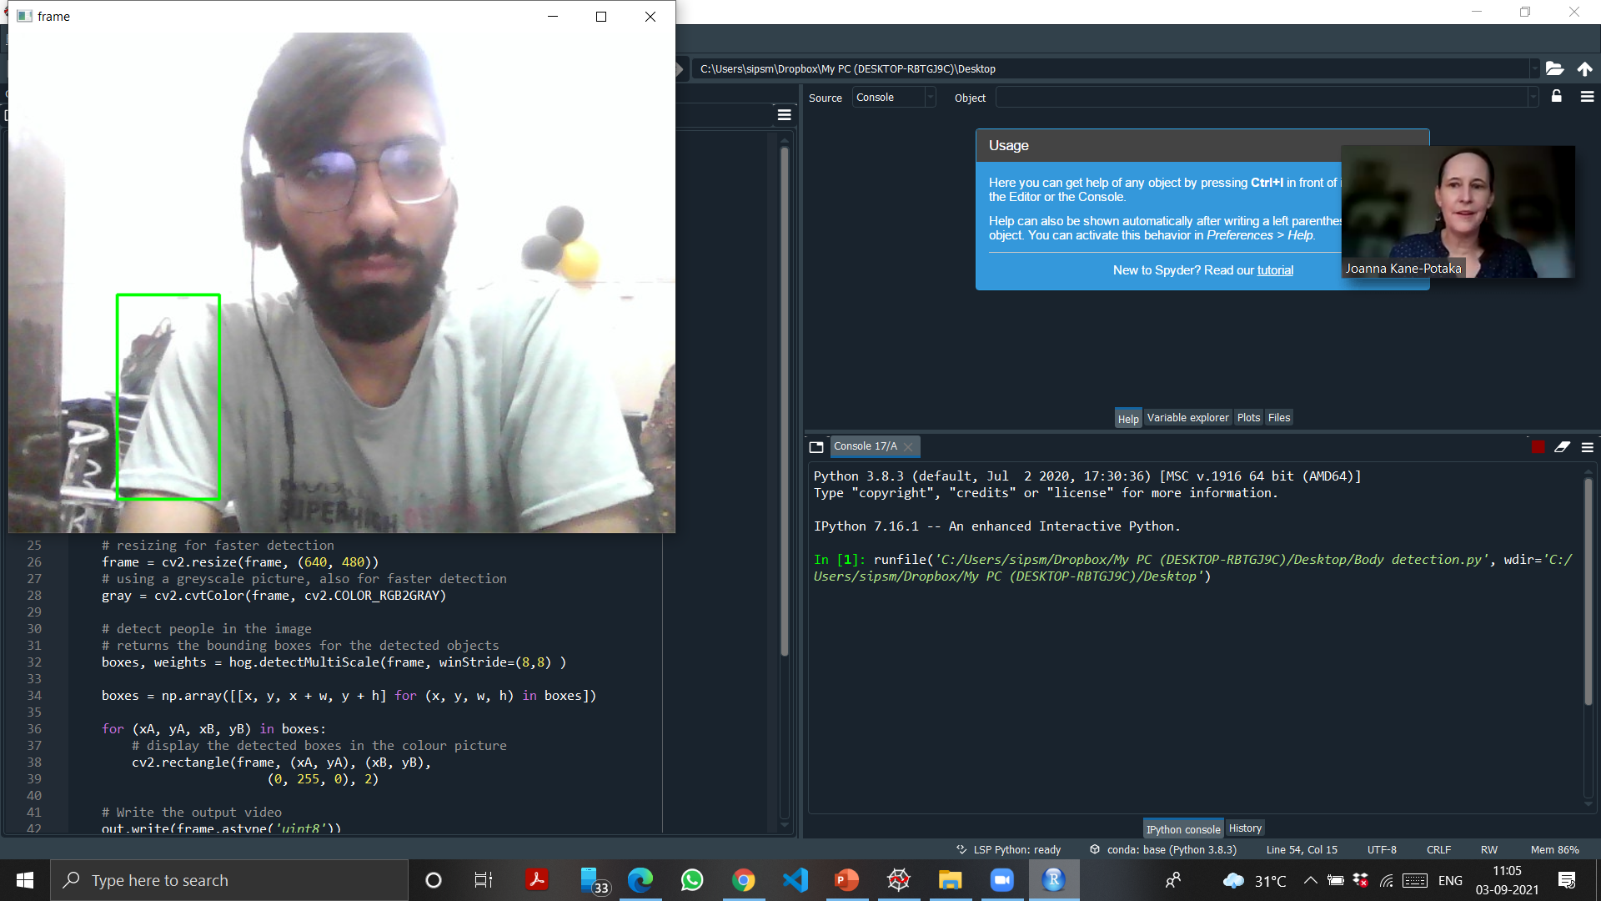

Slide 12
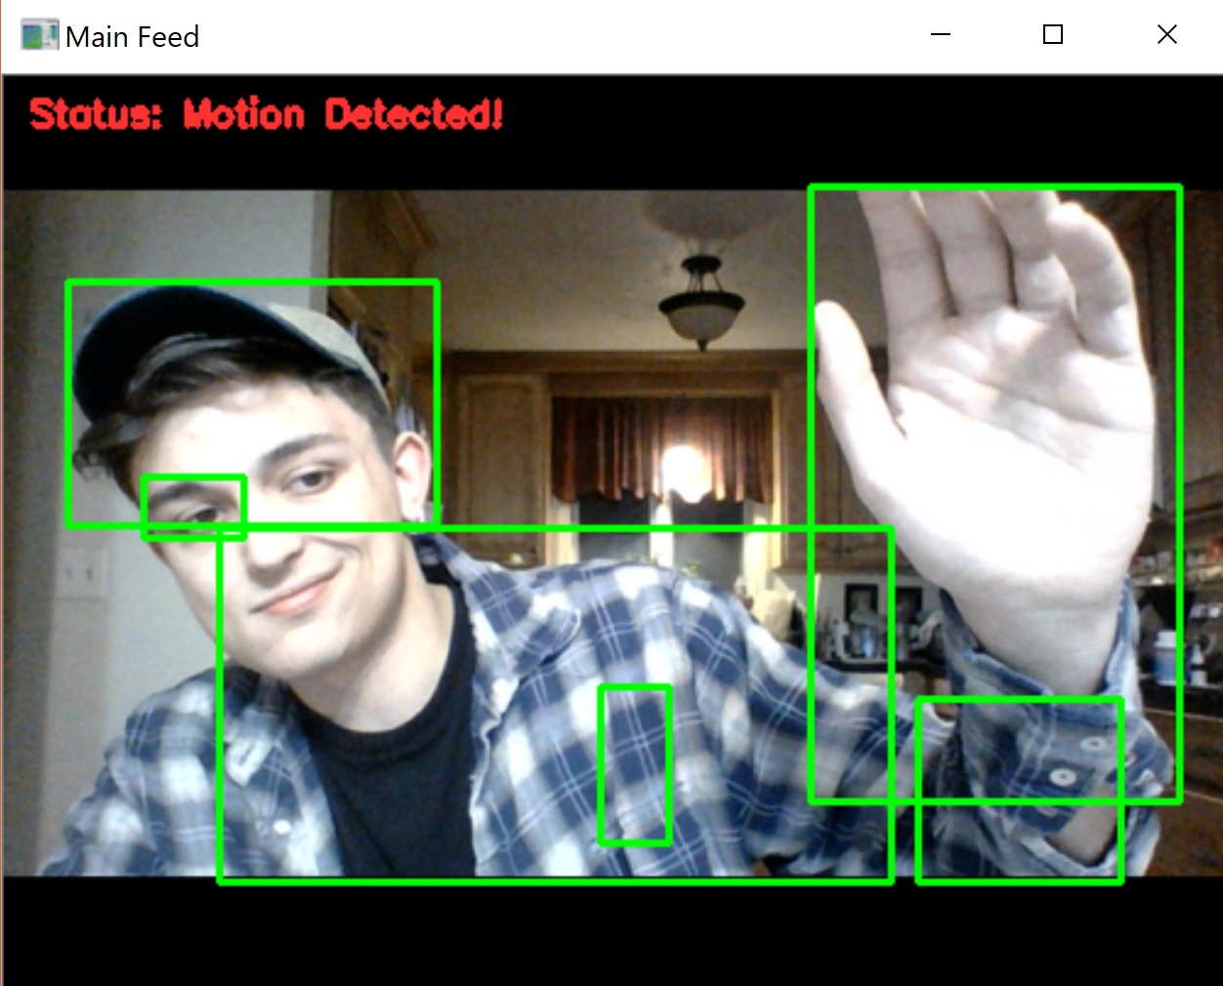

Slide 13
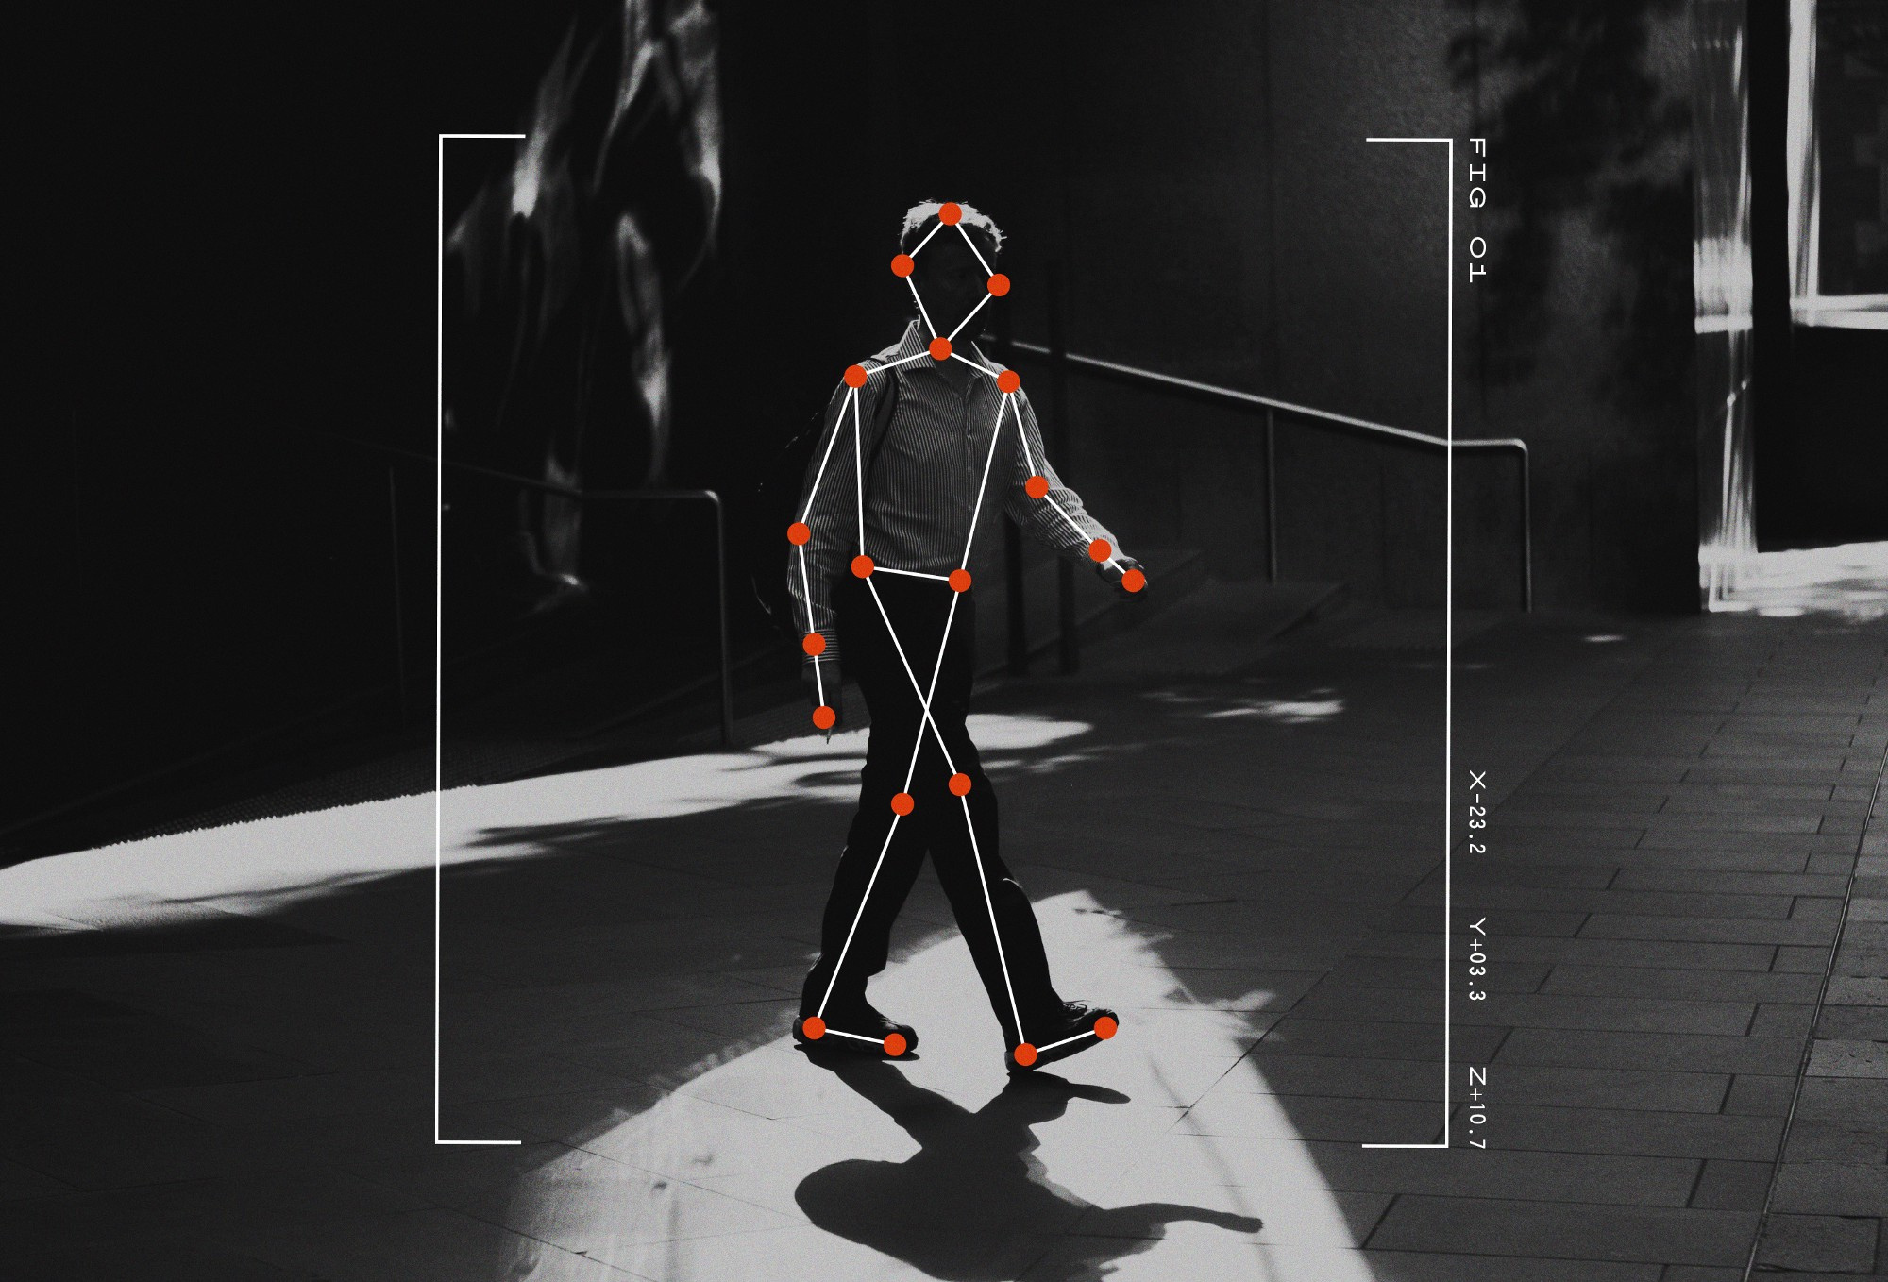


Slide 14

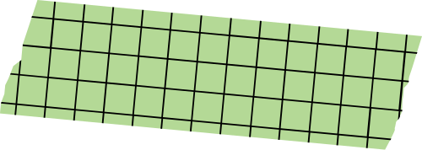

To detect the meaningful words
typed by the employee:
1. We will use text analysis and text processing using natural language processing (NLP).
2. We will use a classifier to tokenize our text into different words.
3. We will remove all unnecessary words that are not relevant.
4. We will use a bag of words to compare the text with the data set.
5. We will use a confusion matrix to classify text into meaningful and useless.
6. We will use Leveraging semantics to find meaningful words using Word2Vec.
7. At last, we will find efficiency of the work done.

Slide 15

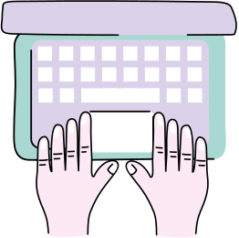


Slide 16

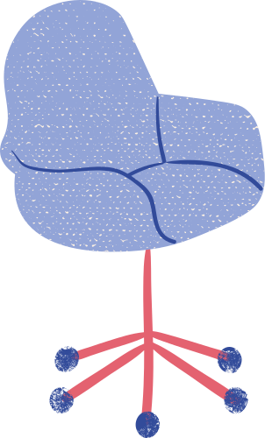
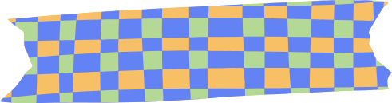
SITTING DETECTION
1. In every MNC’s, every employee has his/her desk and chair.
2. We can deploy a device in the employee’s chair that will measure the pressure that the employee possesses by his/her weight.
3. Our software will be fed by a range of pressure that would be 20 up and 20 low from employee’s pressure.
4. Our software will measure the time duration for which the employee sits regular on his/her seat.

Slide 17
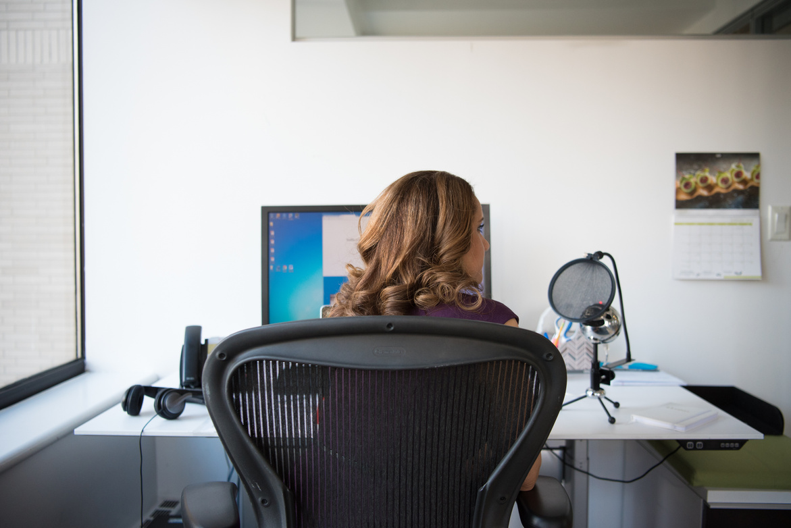
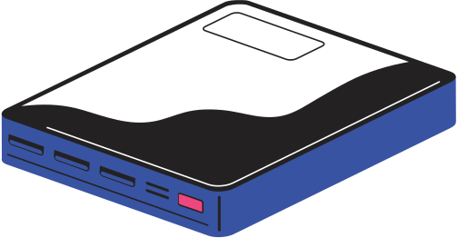
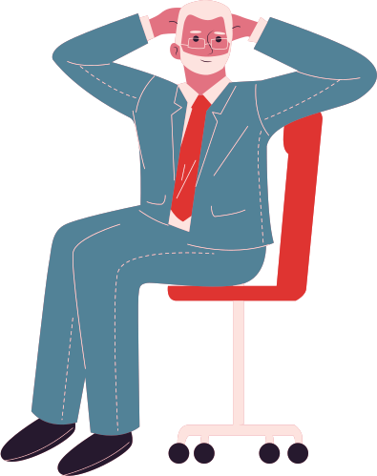

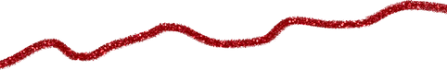

Slide 18

FLAG
1. So, this is an additional feature which we are introducing in this software.
2. This will help the employee in case of any emergency or any sort of business meeting.
3. The employee can switch on the FLAG option which will signify that the employee is with any official authority so that the software can consider that piece of task too.
4. There will be 4 FLAGS given per day to the employee for some informal communications.
5. There will be a list of staff given to every employee in front of every name there will be a FLAG which the employee can raise and the other person can accept or reject that FLAG.
This will save the time and effort of the user.

Slide 19
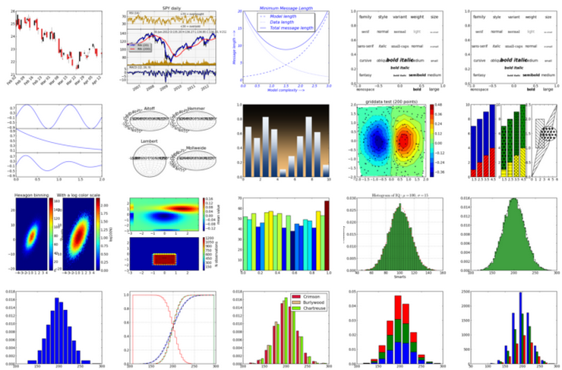
Performance visualization
This Photo by Unknown Author is licensed under CC BY-SA
In data Science we will use Matplotlib for visualization
For Performance visualization we will plot different kind of graphs like bar graphs, Histogram, Violin Plot and many more
It will help more to understand about the performance of a particular employee
It will also help to compare performance of employee’s in MNC’s with each other
5. It will also help company to choose employee of the year by looking at different plots

Slide 20
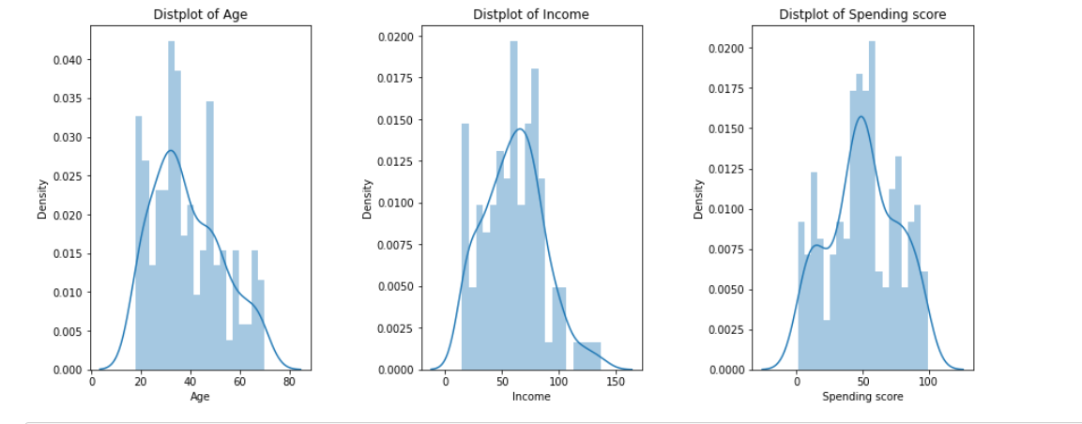
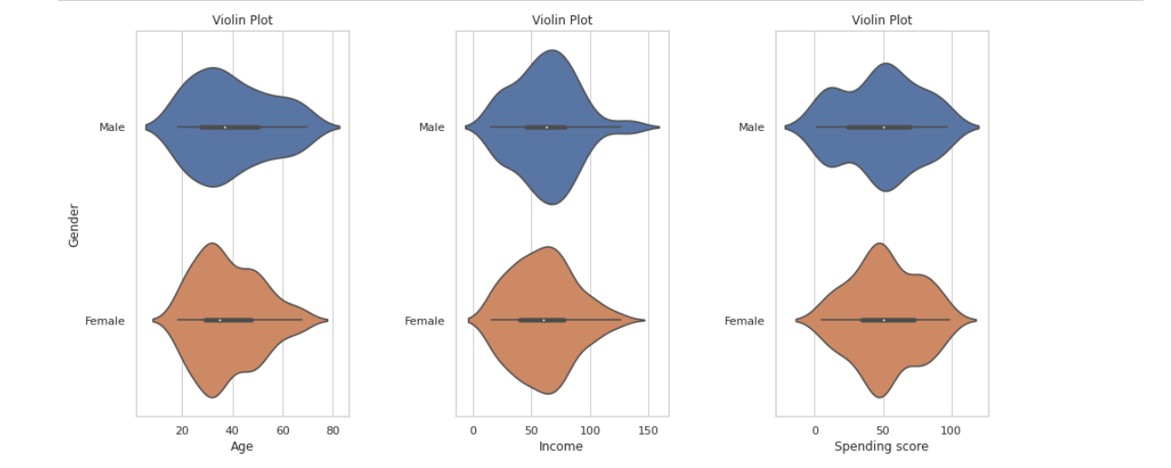
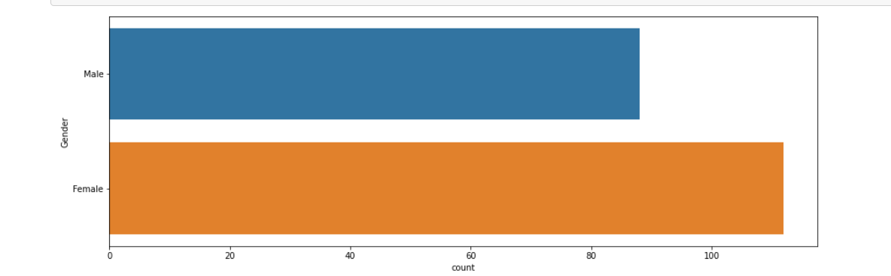

Slide 21

conclusion
This software will help MNC's to boost up their
performance and get efficient work from their employees

